Slide 1
Advanced AI-Powered Adaptive Defense Against Human-Operated Ransomware​
Supervised by​​
​
Dr. Muhammad Yahya Mahmoud (Assistant Professor, COE, KFUPM)​
Dr. Ashraf Mahmoud (Associate Professor, COE, KFUPM)​ Dr. Farid Binbeshr (Post Doctoral Fellow, Intelligent Secure Systems, KFUPM)​
Presented by​
Ransomware-1 Team-1​
​
Md Siddiqur Rahman Tanveer (g202417180)​
F.M. Jahiduzzaman (g202417000)​
​
Department of Computer Engineering​
King Fahd University of Petroleum & Minerals (KFUPM)​

Slide 2
Presentation Outline
Introduction​
Problem Statement and Motivation​
Methodology and Approach​
Implementation Details​
Results and Performance Analysis​
Conclusions and Recommendations

Slide 3
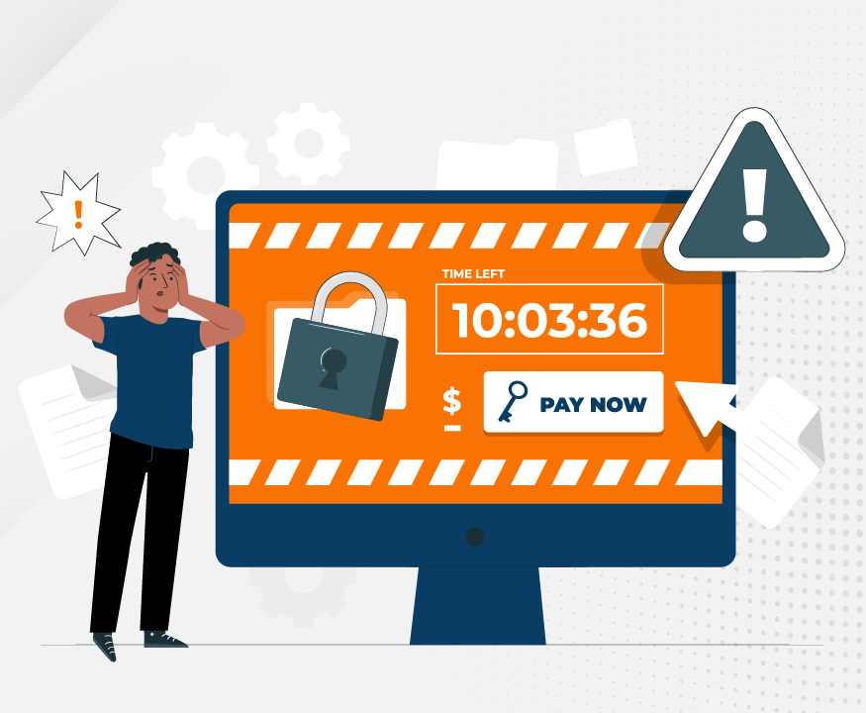
What is a Ransomware?
Ransomware is a type of malware that holds a victim’s sensitive data or device hostage, threatening to keep it locked—or worse—unless the victim pays a ransom to the attacker [1]
Common Ransomware Types
Crypto Ransomware or Encryptors​
Lockers​
Scareware​
Doxware or Leakware​
[1] https://www.ibm.com/topics/ransomware

Slide 4
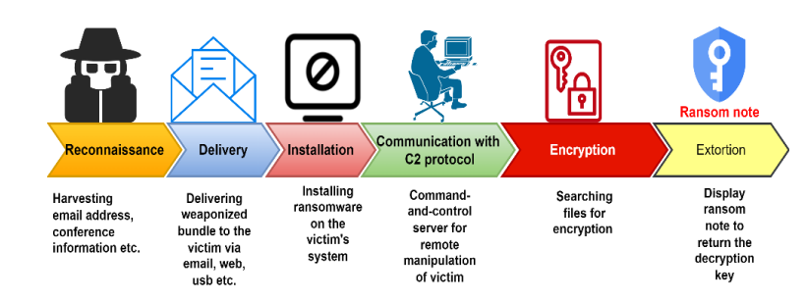
What is Human-operated ransomware?
Human-operated ransomware is a planned and coordinated attack by active cybercriminals who employ multiple attack methods [2]
involves cybercriminals actively [3] like​
"hands-on-keyboard" operations​
focusing on entire organizations ​
The attackers leverage their knowledge of ​
typical system and security misconfigurations​
aim to penetrate the organization​
move laterally across the network​
exploit vulnerabilities.​
[2] https://learn.microsoft.com/en-us/defender-xdr/playbook-detecting-ransomware-m365-defender​
[3] Ferdous, Jannatul, Rafiqul Islam, Arash Mahboubi, and Md Zahidul Islam. "AI-based Ransomware Detection: A Comprehensive Review." IEEE Access (2024).

Slide 5

Evolution of Ransomware models [4]
(Not)Petya
Wannacrypt
Cryptolocker
Human Operated Ransomware
- Enterprise Organization
Opportunistic Ransomware - Single Device
2013
2016
2017
2020
2013 - New Business Model
Monetizes by extorting need to access data (single device)
2019 - Vastly Expands Extortion Scope
to enterprise scale attacks (all data & systems), monetizing major business disruption and/or disclosure of confidential data
[4] https://learn.microsoft.com/en-us/security/ransomware/human-operated-ransomware
Notes:
Key Takeaway: Human Operated Ransomware is likely to (painfully) drive the business case to address longstanding security hygiene and maintenance issues
While ransomware existed in small pockets before, the business model didn’t take off at scale until the introduction of cryptolocker in 2013, which kicked off a surge in this opportunistic, single device way of monetizing cybercrime.
CLICK 1
The most recent phase in ransomware evolution can be traced to WannaCry and (Not)Petya that fused large scale compromise techniques with an encryption payload that demanded a ransom payment in exchange for the decryption key.
This fusion inspired this new generation of human operated ransomware that started popping up around June 2019. This vastly expanded the ransomware business model into an enterprise scale operation blending targeted attack techniques and the extortion business model (threatening disclosure of data and/or encryption in exchange for payment)
Note: While (Not)Petya was likely using ransomware as a smokescreen to hide a destructive intent, it nonetheless planted the seed of an idea that grew into the current business model
Regardless of type of attack, we always strongly discourage paying the ransom as this marks you as a paying victim, funds/incents future attacks, and may expose your organization to liability risk in some organizations.

Slide 6
- high impact & growing another background security risk [4]
Human Operated Ransomware
What’s different?
High Business impact Extortion must disrupt business operations to motivate payment
Stop Business Operations
Human Operated Ransomware
Commodity Ransomware
Profitable for Attackers
Economic incentive to continue growing
Room to Grow
Attackers can monetize security maintenance gaps at most enterprises:
Apply security updates consistently to all computers
Securely configure all resources using manufacturer best practices
Mitigate credential theft attacks for privileged users
Limited Immediate Impact
Commodity
Targeted Data Theft
Per Computer
Enterprise wide
[4] https://learn.microsoft.com/en-us/security/ransomware/human-operated-ransomware
Notes:
Key takeaway: This attack technique will likely grow in volume and business impact until something significant changes in the industry
Much like COVID-19 shifted longstanding industry perceptions on BYOD and remote work, human operated ransomware will likely trigger fundamental shifts in the cybersecurity industry
Organizations face the very real prospect of performing mass restores of system and data to get business operations back up, particularly if they believe that
They won't get hit with this kind of attack
Attackers won’t find unpatched VPNs and operating systems, so maintenance can be deferred again
A password is good enough for admins, so MFA can be deferred
A BC/DR for the worst-case scenario isn't critical, so the difficult business leadership conversations can be deferred
The SOC can manually write every alert and respond using only a SIEM and a firewall block, so modernization with high-quality XDR detections and SOAR can be deferred
CLICK 1 - What’s different?
High Business Impact - Previous attacker models exploited weaknesses in organizations security, but generally had limited business immediate impact or could be managed with limited security improvements:
Commodity attacks– minor business impact that could be managed through marginally better hygiene, existing security tools, and investment into security operations
Targeted data theft – leveraged similar techniques, but often had longer term or indirect impacts on the business (e.g. stronger competitor products) that weren’t immediately stopping business operations. Mitigation with improved security operations can help bring this risk down (but not eliminate).
Commodity ransomware – actively disrupted access to data and systems using extortion techniques, but was limited to exploited this,
CLICK 2 - Extortion
Human operated ransomware builds on all of these to grow the extortion payments to be much larger.
For extortion to work, the attackers must have control over something the victim will be willing to pay to get back, in this case the ability to operate their business. Human operated ransomware combines two existing techniques into a highly damaging combination:
Gain enterprise control with credential theft – pioneered in targeted data theft attacks
Deny access to data – established with commodity ransomware
This frequently allows attack operators to stop all business operations until payment is rendered (and sometimes not even then). We don’t recommend that organizations pay ransom.
CLICK 3 – Profitable for Attackers
As you may imagine, this is a profitable, though immoral, endeavor for the attackers. The profits from past attacks fuel confidents in future attack profits and the funding required to conduct them, creating the ingredients for a significant growth trajectory of these attacks.
We actively discourage paying the ransomware. While we understand that desperate measures are sometimes attractive, there is no guarantee that the payment will result in a decryption key, in a key that decrypts all data/systems (vs. a fraction of them), or even that the attackers won’t sell data on the dark markets anyway. Additionally, paying groups may put the organization at risk of
CLICK 4 – Room to grow
Additionally, there is a lot of room for these attacks to grow because of the way enterprises have balanced operational and security requirements over the past decades.
Most enterprises organizations have consistently chosen to prioritize business functionality and operational speed over security considerations. While this made businesses more efficient because security threats were limited to an acceptable level, these choices also accumulated a massive backlog of technical debt in the form of security hygiene issues that attackers could potentially exploit.
While these maintenance hygiene issues were silent and invisible for a long time (even when exploited to for intellectual property theft by advanced attackers), these issues will not stay silent and invisible any longer.
We cannot emphasize this enough – the secret of “we never got around to doing that security thing” is out to attackers who can profit from it at scale using business-disrupting extortion techniques (and are getting better at it with each attack).
We don’t expect to see this trend slow, stop, or reverse until something significant changes in attacker deterrence (attacker arrests, extradition laws removing safe harbor countries, etc.) or defender resilience (widespread executive support for security, close cultural coordination between IT and security teams, etc.)

Slide 7




Pattern–
Human Operated Ransomware[4]
ENTER ENVIRONMENT
TRAVERSE & SPREAD
EXECUTE OBJECTIVES
Attacker gains access to organization
Attacker gains administrative access to organization
Encryption Lock up Data
Client Attacks
Email, Credential, Browser, etc.
Credential Theft
Credential Theft
Logon with legit creds
Exfiltration Steal Data
Extortion Demand Money
Datacenter Attacks
RDP, SSH, Server, App, etc.
Malware Installation
Sabotage Backup/Recovery
Establish persistence
Ransomware actors sometimes buy access to target organizations from other attackers in dark markets
Human Attack Operator(s)
Assisted by scripts and malware
[4] https://learn.microsoft.com/en-us/security/ransomware/human-operated-ransomware
Notes:
Key Takeaway: This is the attack flow for human operated ransomware,
The ransomware attackers favor cheap and efficient attack methods such as password spray and unpatched known vulnerabilities (e.g. zerologon), and also purchase access to target organizations from other criminals.
These attackers also focus on sabotaging recovery of business operations by erasing or encrypting backups and network documentation like solarwinds to try and force organizations to pay the ransom.

Slide 8
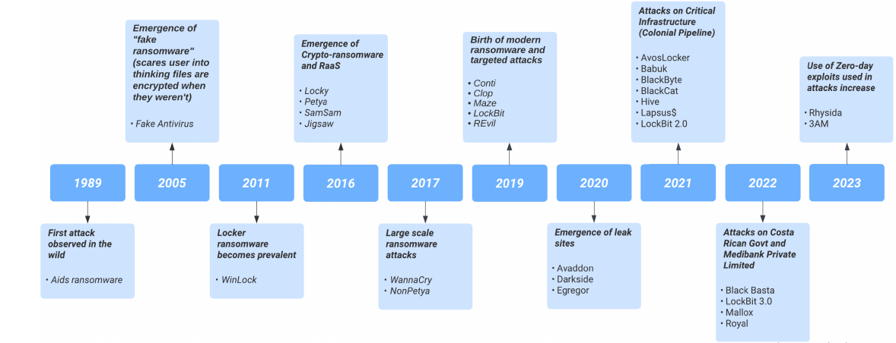
Timeline Evolution of Different Ransomwares [5]
[5] Ispahany, Jamil, MD Rafiqul Islam, Md Zahidul Islam, and M. Arif Khan. "Ransomware detection using machine learning: A review, research limitations and future directions." IEEE Access (2024).

Slide 9
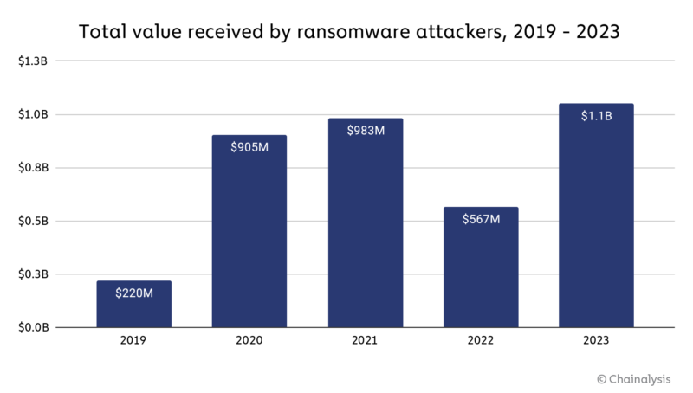
Financial Loss Due to Ransomware Attacks
2023: A watershed year for ransomware [6]
[6] https://www.chainalysis.com/blog/ransomware-2024/

Slide 10
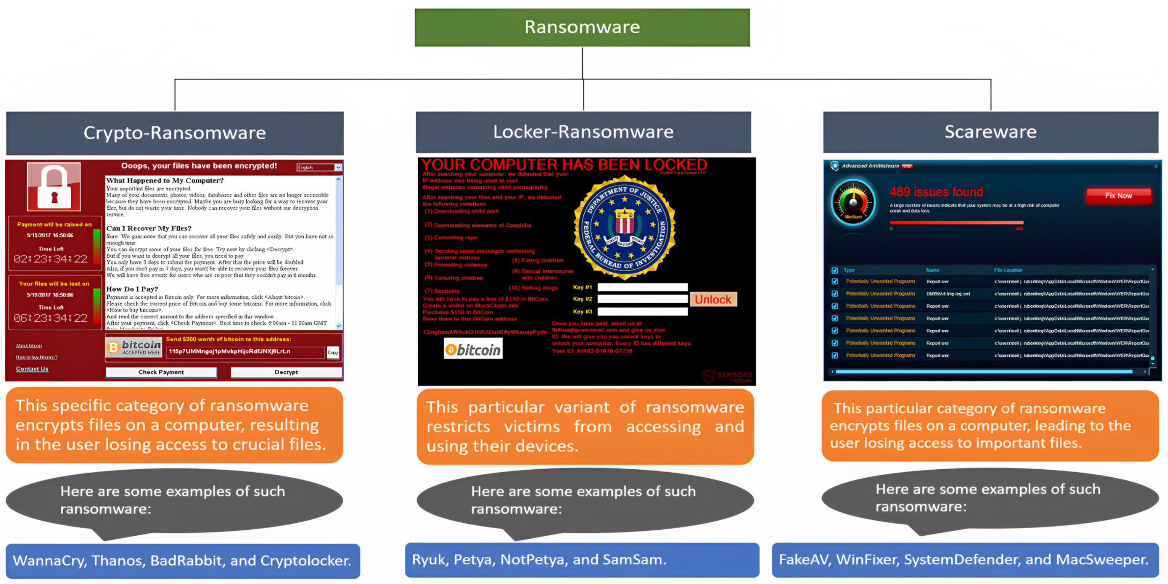
Most Common Human Operated Ransomware Types
[7] Alraizza, Amjad, and Abdulmohsen Algarni. "Ransomware detection using machine learning: A survey." Big Data and Cognitive Computing 7, no. 3 (2023): 143.

Slide 11
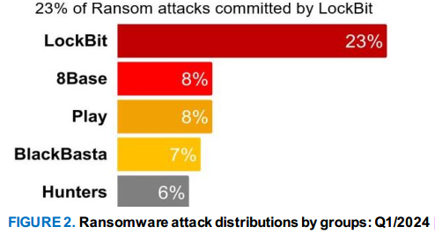
Point of Research Interest
Cybersecurity and threat actors are racing to develop advanced AI-driven solutions [5]. They are utilizing
Machine Learning (ML) algorithms to
identify vulnerabilities in a target system
exploit them to gain access
encrypt data
rendering them unusable until a ransom is paid.
Artificial Intelligence (AI) algorithms to
adapt and evolve tactics based on the defenses of a target
making it increasingly difficult to detect and mitigate attacks.
Examples of AI-powered ransomware attacks include “LockBit 2.0”, released in January 2023, which can encrypt more data and demand higher ransomware [3]
[3] Ferdous, Jannatul, Rafiqul Islam, Arash Mahboubi, and Md Zahidul Islam. "AI-based Ransomware Detection: A Comprehensive Review." IEEE Access (2024).

Slide 12
Existing Approaches to Defend Against Ransomware
Year | Authors | Proposed Solution | Model | Dataset | Samples | Features | Outcomes
2016 | Kharraz et al. [8] | Dynamic analysis system called UNVEIL | Statistical | Custom Generated | 148,223 | 30967 | Total Samples: 148,223 Detected Ransomware: 13,637 Detection Rate: 96.3% False Positives: 0.0% New Detection: 9,872 (72.2%)
2021 | Almousa et al [9] | API-based obfuscation techniques | k-NN SVM RF | Custom Generated | Ransomware: 58 Good: 66 | 206 common API Calls | K-NN : 99.18%, FP: 1 SVM: 83.60%, FP: 17 RF: 87%, FP: 12
2022 | Masum et al. [10] | ML based detection | DT, RF, NB, LR, NN | Publicly available but Custom Generated | 138047 70 % Good 30% Ransom | 13 | DT: 0.98±0.01 RF: 0.99±0.01 NB: 0.35±0.03 LR: 0.96±0.02 NN: 0.97±0.01
[8] Kharaz, A., Arshad, S., Mulliner, C., Robertson, W., & Kirda, E. (2016). {UNVEIL}: A {Large-Scale}, automated approach to detecting ransomware. In 25th USENIX security symposium (USENIX Security 16) (pp. 757-772).
[9] Almousa, M., Basavaraju, S., & Anwar, M. (2021, December). Api-based ransomware detection using machine learning-based threat detection models. In 2021 18th International Conference on Privacy, Security and Trust (PST) (pp. 1-7). IEEE
[10] Masum, M., Faruk, M. J. H., Shahriar, H., Qian, K., Lo, D., & Adnan, M. I. (2022, January). Ransomware classification and detection with machine learning algorithms. In 2022 IEEE 12th Annual Computing and Communication Workshop and Conference (CCWC) (pp. 0316-0322). IEEE.

Slide 13
Existing Approaches to Defend Against Ransomware
Year | Authors | Proposed Solution | Model | Dataset | Samples | Features | Outcomes
2023 | Moreira et al [11] | Static analysis approach for detecting ransomware by converting PE headers into color images | CNN | Dataset 1 generated, Publicly available but Generated Dataset 2 | Dataset 1: R: 10,138 B: 10,138 Dataset 2: R: 9,738 B: 9,738 | 1024 | Dataset 1: Accuracy: 97.03% Dataset 2: Accuracy: 93.28%
2023 | Zumtaugwald and Gagulic [12] | Storage Access pattern analysis | RF, XGBoost, DNN | Generated |  | 9 | XGBoost & RF: Up to 97.3% DNN: Up to 95.6%
2024 | Alhaidari [13] | Mechanism utilizing memory artifacts | XGBoost, RF, LightGBM, Adaptive Boosting, Extra Tree | Generated | Ransom: 586 Benign: 579 | 58 | XGBoost (with all features): 97.85% Random Forest (with 16 selected features): 97%
[11] Moreira, C. C., Moreira, D. C., & de Sales Jr, C. D. S. (2023). Improving ransomware detection based on portable executable header using xception convolutional neural network. Computers & Security, 130, 103265. [12] Ransomware Detection with Machine Learning with Storage Systems, Dario Gagulic, Lynn Zumtaugwald, Siddhant Sahu, Dr. Alberto Huertas, Jan von der Assen and Dr. Roman Pletka (IBM Research Lab Zurich), University of Zurich Department of Informatics (IFI), Binzmühlestrasse 14, CH-8050 Zürich, Switzerland [13] Aljabri, M., Alhaidari, F., Albuainain, A., Alrashidi, S., Alansari, J., Alqahtani, W., & Alshaya, J. (2024). Ransomware detection based on machine learning using memory features. Egyptian Informatics Journal, 25, 100445.

Slide 14
Existing Approaches to Defend Against Ransomware
Ransomware Detection Based on Data
Static Analysis
Dynamic Analysis
Static analysis examines binary structural properties or content to identify potential vulnerabilities. Such as PE metadata
Dynamic or behavioral analysis involves executing and observing suspicious files in a controlled environment, such as a virtual machine or emulator, to understand their behavior and actions better. Such as Windows API Calls, Registry Operation, File operation etc.
Dynamic analysis is necessary because some ransomware can detect virtual environments and avoid displaying malicious behaviors

Slide 15
Finding The Gaps
Dataset Availability
Most Datasets are not publicly available
Lack of original Dataset
Most of the Datasets are generated by the authors
Identifying Ransomware behaviors
Ransomware behaviors are very dynamic
Nowadays, ransomware adopts evasion techniques
Ransomware exploits zero day attacks
Detection Approach
Static approaches let malicious file not to act that’s why ransomware behaviors are difficult to identify
Dynamic approaches let the malicious file to act in a quarantine environment so that actual behaviors are not sometimes exploited by ransomware

Slide 16
Research Questions
How can AI models be effectively trained to detect and respond to human-operated ransomware attacks in real-time?
What machine learning techniques can be employed to dynamically adapt to new attack patterns and evasion tactics used by ransomware operators?
How can human-operated ransomware be distinguished from commodity ransomware using advanced AI techniques?

Slide 17
Methodology
Data Collection
AI Model Training
Evaluation
Data Preprocessing
Features Selection
Relevant Features Extraction
Dataset collection
Publicly available data sources
Static and Dynamic behaviors dataset.
Data Preprocessing and cleaning
Clean the dataset if there exists any null or non numeric values
Tools and Library: Excel, Python, Pandas, Numpy
Correlated Features Selection
Select mostly correlated static and dynamic features
Mathematical Model: Pearson heatmap
Relevant Features Extraction
Select most relevant features and drop the less relevant features
Mathematical Model: Information value (IV), Weight of Evidence (WoE) Train AI Model
Train several AI models using these extracted features against the dataset
Tools: Google Colab Evaluation
Evaluate the performance by several metrics
Metrics: Confusion matrix, Accuracy, Precision, Recall, F1 score, False Positive Rate

Slide 18
Proposed Solution
Dataset
Pre-Processing
Pearson Heatmap
Features Selection and Extraction
Model Train and Ransomware Detection
IV and WoE
Safe
Ransomware

Slide 19
Experimental Analysis
Dataset Collection, Preprocessing and Cleaning
Static and Dynamic behaviors dataset.
Dataset
Dynamic Analysis
Static Analysis

Slide 20
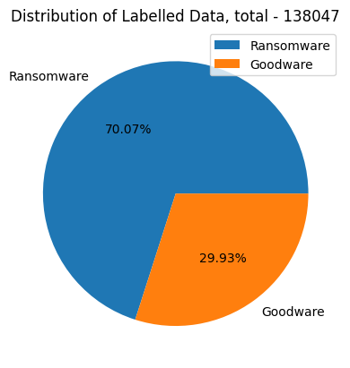
Implementation for Static Analysis
Correlated Features Selection
Select mostly correlated static and dynamic features
Mathematical Model: Pearson heatmap
PE headers Data Features: 54 Goodware : 41323
Ransomware : 96724

Slide 21
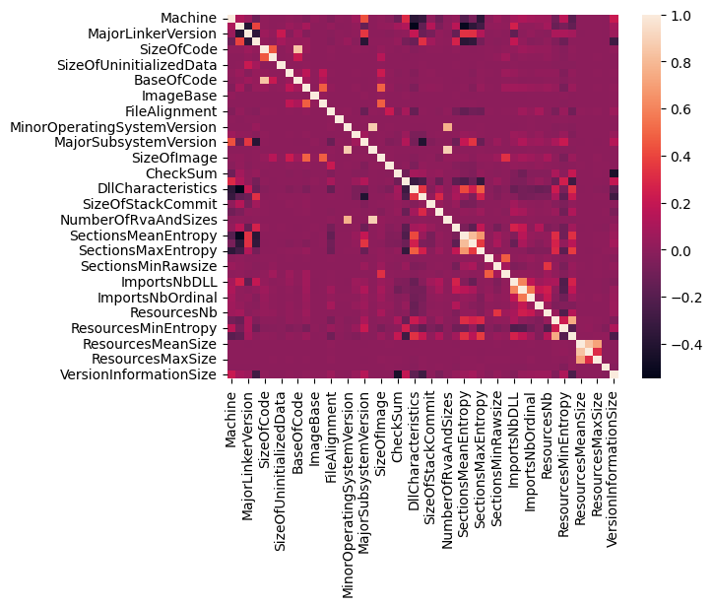
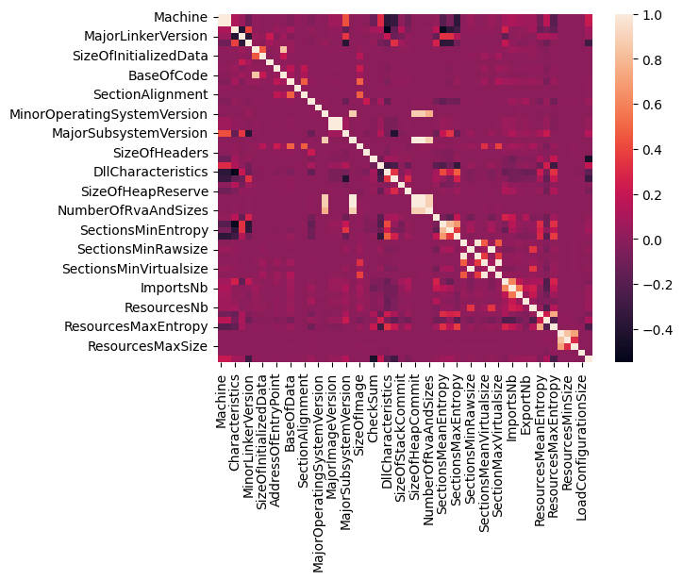
Implementation for Static Analysis
Dropping Highly Correlated Features
Select mostly correlated static and dynamic features
Mathematical Model: Pearson heatmap
Dropped Features
['SizeOfOptionalHeader', 'MinorImageVersion', 'SizeOfHeapCommit', 'LoaderFlags', 'SectionMaxRawsize', 'SectionsMinVirtualsize', 'SectionMaxVirtualsize']

Slide 22

Implementation for Static Analysis
Relevant Features Extraction
Select most relevant features and drop the less relevant features
Mathematical Model: Information value (IV), Weight of Evidence (WoE)
WOE = In(Distribution of Goods ➗ Distribution of Bads)
IV = ∑ (Distribution of Goods ➗ Distribution of Bads) * WOE
36 features
['SizeOfHeaders', 'FileAlignment', 'SectionAlignment', 'MajorImageVersion', 'LoadConfigurationSize', 'SizeOfUninitializedData', 'ImportsNbOrdinal', 'MinorOperatingSystemVersion', 'MinorLinkerVersion', 'MinorSubsystemVersion', 'SectionsNb', 'ResourcesMeanEntropy', 'ImportsNbDLL', 'SectionsMinEntropy', 'SectionsMeanEntropy', 'CheckSum', 'ResourcesMeanSize', 'SectionsMinRawsize', 'ResourcesMaxEntropy', 'ImportsNb', 'SectionsMeanVirtualsize', 'AddressOfEntryPoint', 'ResourcesMaxSize', 'DllCharacteristics', 'SizeOfCode', 'SectionsMeanRawsize', 'Machine', 'ExportNb', 'MajorLinkerVersion', 'SizeOfImage', 'BaseOfData', 'ResourcesMinEntropy', 'Subsystem', 'ResourcesNb', 'MajorSubsystemVersion', 'SizeOfInitializedData']

Slide 23
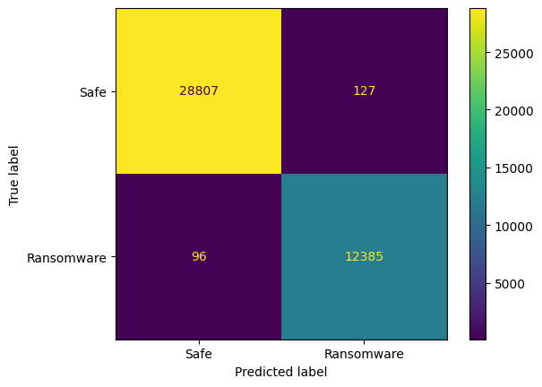


Train the Model for these features
Random Forest
Decision Tree
XGBoost

Slide 24
Performance Analysis For Static Analysis Dataset
Our Study | RF | DT | XGBoost | Masum et. al. [14] | DT | RF
Accuracy | 0.9946 | 0.9906 | 0.9950 |  | 0.98±0.01 | 0.99±0.01
Precision | 0.9898 | 0.9825 | 0.9903 |  | 0.98±0.00 | 0.99±0.00
Recall | 0.9923 | 0.9863 | 0.9930 |  | 0.94±0.05 | 0.97±0.03
F1 Score | 0.9911 | 0.9844 | 0.9916 |  | 0.94±0.05 | 0.97±0.03
False Positive Rate | 0.0044 | 0.0044 | 0.0042
AUC Score | 0.9997 | 0.9894 | 0.9998
[14] Masum, Mohammad, Md Jobair Hossain Faruk, Hossain Shahriar, Kai Qian, Dan Lo, and Muhaiminul Islam Adnan. "Ransomware classification and detection with machine learning algorithms." In 2022 IEEE 12th Annual Computing and Communication Workshop and Conference (CCWC), pp. 0316-0322. IEEE, 2022.

Slide 25
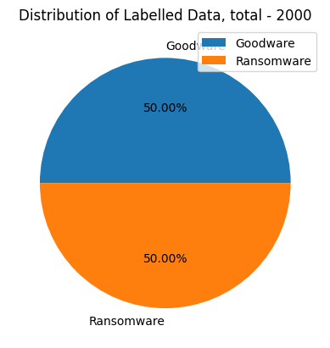
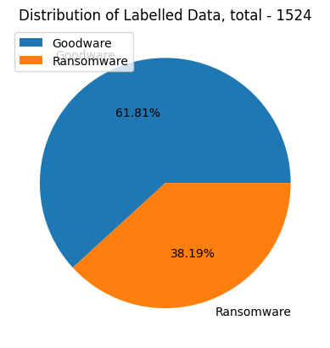
Implementation for Dynamic Analysis
Behaviors Features Dataset
Dataset 1 Features: 50
Ransomware: 1000 Goodware: 1000
Dataset 2 Features: 30967 Ransomware: 582 Goodware: 942

Slide 26
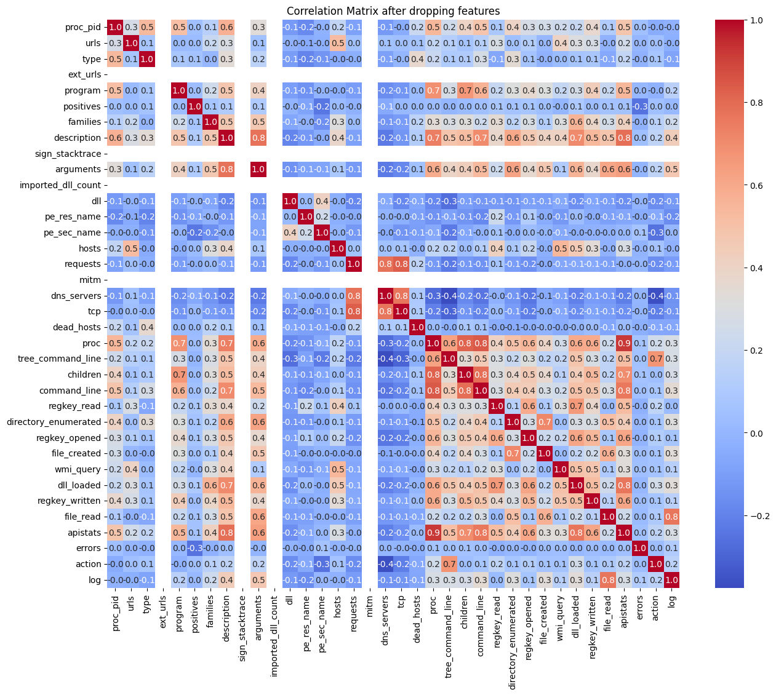
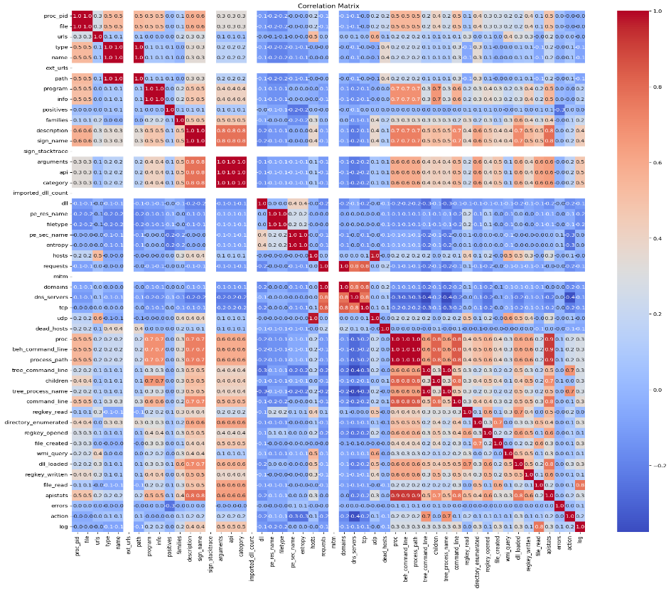
Dataset 1 Dynamic Analysis
Dropping Highly Correlated Features
Select mostly correlated dynamic features
Mathematical Model: Pearson correlation matrix
Dropped Features
['file', 'name', 'path', 'info', 'sign_name', 'api', 'category', 'filetype', 'entropy', 'domains', 'udp', 'beh_command_line', 'process_path', 'tree_process_name']

Slide 27
Dataset 1 Dynamic Analysis
Relevant Features Extraction
Select most relevant features and drop the less relevant features
Mathematical Model: Information value (IV), Weight of Evidence (WoE)
WOE = In(Distribution of Goods ➗ Distribution of Bads)
IV = ∑ (Distribution of Goods ➗ Distribution of Bads) * WOE
25 features regarding 0< IV <1.3
['positives', 'errors', 'dns_servers', 'dead_hosts', 'children', 'hosts', 'requests', 'tcp', 'action', 'regkey_opened', 'families', 'urls', 'wmi_query', 'dll_loaded', 'type', 'command_line', 'tree_command_line', 'program', 'proc', 'proc_pid', 'regkey_read', 'regkey_written', 'dll', 'apistats', 'file_read']

Slide 28
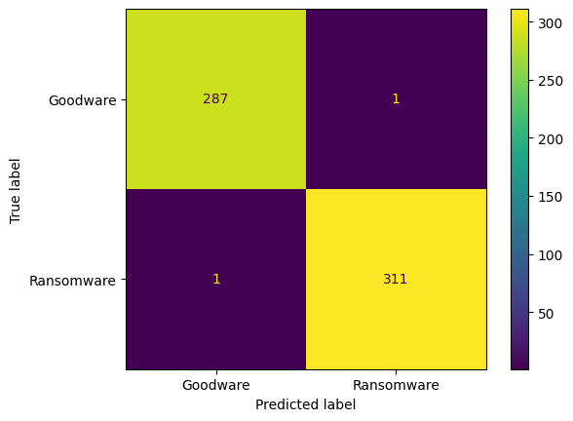

Train the Model for Dataset 1
Random Forest
XGBoost

Slide 29


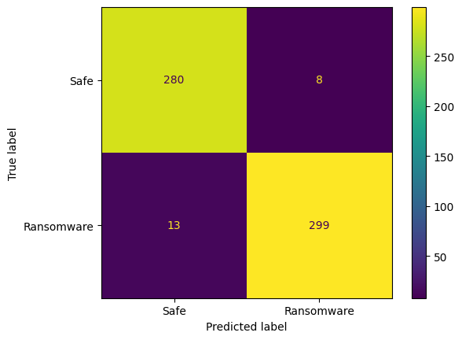
Train the Model for Dataset 1
Decision Tree
KNN
Neural Network

Slide 30
Performance Analysis for Dataset 1
Metrics | RF | XGBoost | DT | KNN | NN | Herrera et. al. [15] | RF | NN
Accuracy | 0.9967 | 0.9983 | 0.9817 | 0.9750 | 0.9650 |  | 99.0 | 91.92
Precision | 0.9968 | 0.9968 | 0.9839 | 0.9685 | 0.9739 |  | 98.19 | 92.31
Recall | 0.9968 | 1.0000 | 0.9808 | 0.9840 | 0.9583 |  | 96.36 | 90.55
F1 Score | 0.9968 | 0.9984 | 0.9823 | 0.9762 | 0.9661 |  | 92.25 | 92.12
MCC | 0.9933 | 0.9967 | 0.9633 | 0.9500 | 0.9301
False Positive Rate | 0.0035 | 0.0035 | 0.0174 | 0.0347 | 0.0278
AUC Score | 1.0000 | 1.0000 | 0.9990 | 0.9910 | 0.9971
[15] Herrera-Silva, Juan A., and Myriam Hernández-Álvarez. "Dynamic feature dataset for ransomware detection using machine learning algorithms." Sensors 23, no. 3 (2023): 1053.

Slide 31
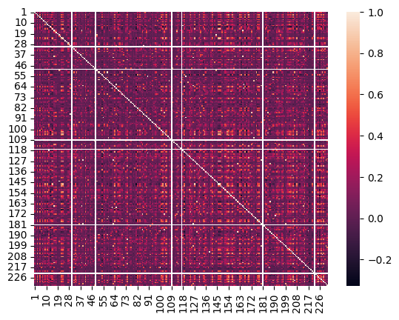
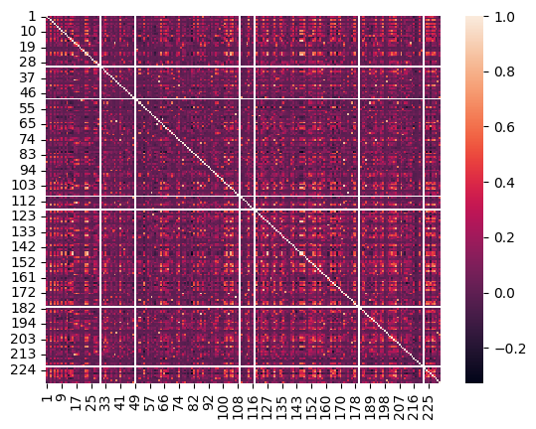
Dataset 2 Dynamic Analysis
Dropping Highly Correlated Features
Select mostly correlated dynamic features from 232
Mathematical Model: Pearson heatmap
Dropped Features
['58', '87', '90', '118', '120', '126', '144', '165', '166', '180', '186', '187', '191', '204', '214', '217', '228']

Slide 32
Dataset 2 Dynamic Analysis
Relevant Features Extraction
Select most relevant features and drop the less relevant features
Mathematical Model: Information value (IV), Weight of Evidence (WoE)
WOE = In(Distribution of Goods ➗ Distribution of Bads)
IV = ∑ (Distribution of Goods ➗ Distribution of Bads) * WOE
201 features have been selected regarding 0< IV<1
['59', '86', '174', '78', '40', '132', '44', '45', '111', '231', '196', '206', '112', '57', '42', '103', '192', '176', '21', '107', '185', '83', '193', '10', '72', '106', '219', '155', '55', '94', '133', '20', '89', '139', '47', '36', '53', '26', '80', '39', '18', '199', '173', '97', '17', '151', '158', '221', '19', '169', '136', '77', '2', '175', '137', '50', '63', '159', '172', '71', '4', '122', '198', '207', '75', '213', '116', '74', '194', '1', '35', '25', '113', '223', '209', '232', '95', '179', '14', '183', '150', '160', '37', '145', '201', '140', '60', '16', '203', '70', '128', '195', '73', '215', '152', '149', '24', '76', '32', '210', '34', '200', '38', '123', '171', '12', '184', '85', '115', '188', '93', '98', '28', '91', '189', '182', '92', '100', '125', '69', '138', '41', '29', '6', '227', '33', '130', '141', '8', '121', '110', '13', '96', '62', '31', '65', '218', '52', '51', '211', '162', '142', '56', '15', '43', '48', '108', '212', '131', '66', '79', '124', '46', '88', '208', '114', '202', '134', '164', '3', '225', '143', '205', '156', '135', '61', '67', '230', '99', '170', '190', '68', '5', '81', '9', '177', '153', '220', '216', '11', '102', '127', '104', '157', '163', '23', '105', '146', '84', '154', '147', '229', '129', '178', '161', '168', '197', '82', '27', '226', '101']

Slide 33
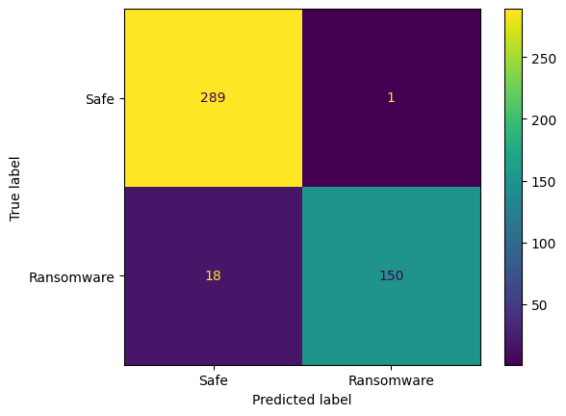


Performance Analysis for Dataset 2
Random Forest
Decision Tree
XGBoost

Slide 34
Performance Analysis for Dataset 2
ID | Ransomware Family | RF | DT | XGBoost
1 | Critroni | 18 | 18 | 18
2 | CryptLocker | 28 | 27 | 28
3 | CryptoWall | 9 | 8 | 8
4 | KOLLAH | 9 | 9 | 9
5 | Kovter | 14 | 16 | 15
6 | Locker | 22 | 21 | 21
7 | MATSNU | 14 | 13 | 14
8 | PGPCODER | 1 | 1 | 1
9 | Reveton | 23 | 23 | 22
10 | TeslaCrypt | 2 | 2 | 2
11 | Trojan-Ransom | 10 | 10 | 10
Metrics | RF | DT | XGBoost
Accuracy | 0.9563 | 0.9345 | 0.9476
Precision | 0.9868 | 0.9367 | 0.9737
Recall | 0.8929 | 0.881 | 0.881
F1 Score | 0.9375 | 0.908 | 0.925
MCC | 0.9067 | 0.8582 | 0.8875
False Positive Rate | 0.0069 | 0.0345 | 0.0138
AUC Score | 0.9853 | 0.9571 | 0.9892

Slide 35
Conclusions and Recommendations
Key Project Achievements​
Developed an effective machine-learning-based model for ransomware detection.​
Highlighted the feasibility of early ransomware detection in diverse environments.
Lessons Learned
Importance of selecting distinctive features for enhanced accuracy.​
Challenges in balancing computational efficiency and detection performance.​
Variability in results depending on dataset quality and diversity.

Slide 36
Conclusions and Recommendations
Limitations​
Can’t incorporate explain ability to define the relevant features
Potential performance degradation in real-world, unseen scenarios.​
Due to lack of large datasets zero day exploitation can’t be defended.
Future Enhancement Strategies
Integration of real-time monitoring and automated response mechanisms.​
Exploration of hybrid detection methods combining static and dynamic features.​
Expansion to include zero-day ransomware detection using advanced techniques.
Incorporate Explainable AI to clearly represent the relevant features to get more accuracy and less False positive rates.

Slide 37
Conclusions and Recommendations
Potential Real-World Applications
Deployment in organizational cybersecurity systems to prevent data breaches.​
Utilization in antivirus and endpoint protection tools.​
Contributions to threat intelligence and proactive ransomware mitigation.

Slide 38
Thank You

